Slide 1
Beyond E-Trading
Fixed income E-trading matured to the point that it is enabling new business models
Presented to:
Dallas, Texas
August 22nd, 2019

Slide 2
Beyond E-Trading: Disintermediation and Alternative Execution Methods - Agenda
E-trading is Shifting the Liquidity Landscape
Non-Dealer Market Makers
Portfolio Trading
Auto-Execution/Direct Streams

Slide 3
E-Trading Shifts the Landscape

Slide 4
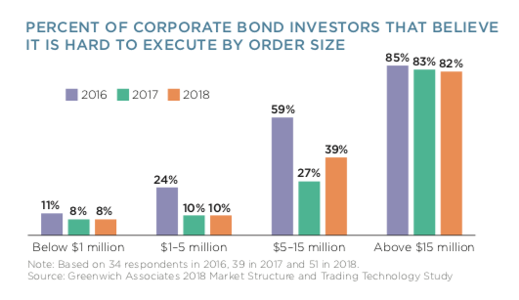
Ease of Execution by Order Size

Slide 5
Where is the liquidity of the future?
Are these sources as distinct as they seem?
Base: 57
Source: 2018 Market Structure & Trading Technology Study.

Slide 6
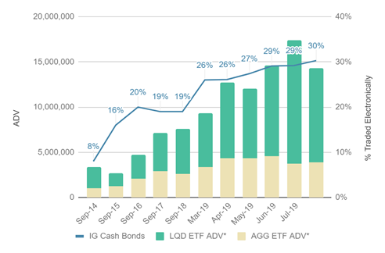
Fixed Income ETFs vs. Cash Bond E-Trading: Closely Linked, but which drives which?

Slide 7
Non-Dealer Market Makers

Slide 8
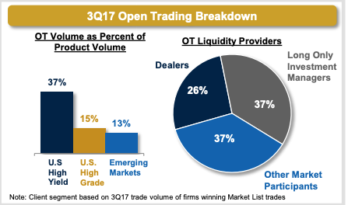
Who are these “Other Market Participants?” Non-dealer market makers
Source: MarketAxess

Slide 9
Non-dealer Market Makers are Playing an Increasing Role Across Fixed Income
Non-dealer market makers are proprietary trading firms that use e-trading platforms in place of a sales force for distribution
In U.S. Treasuries, they dominate the inter-dealer market and are now going direct to customers through platforms like Fenics and LiquidityEdge
In Credit markets they are very large participants on all platforms
They are generally private firms, organized as hedge funds
Their business model relies on several factors
Access to order flow over electronic platforms
ETF create-redeem arbitrage
Wholesale-retail arbitrage
Greater balance sheet leverage by shorting ETFs against their long bond portfolios
This last point puts them in a position to compete with banks

Slide 10
Portfolio Trading

Slide 11
The Technology and the Techniques of the ETF Create-Redeem Arbitrage are being Re-purposed to Support Portfolio Trading
Similar to the way in which index arbitrage led to program trading in equities
Cash vs futures arbitrage was very profitable
To reduce costs, firms tried to conduct the arbitrage with smaller baskets than the full index
The tracking baskets had “tracking error” vs. the index
Tracking error itself became tradable and measurable per instrument
The application of this to fixed income is significant
It permits ETF liquidity to be transmitted to the individual bonds
As modelling and hedging techniques become more significant, the ETF liquidity can spread beyond the bonds in the create-redeem baskets
Portfolio trading firms seem to believe that in fixed income both price and liquidity risk management in fixed income have scale economies
Many firms are looking to get into this business

Slide 12
Auto-Execution/Direct Streams

Slide 13
Auto-Execution: Coming Soon, or Already Here?

Slide 14
Auto-Execution and Auto-Quoting are the Next Phase
The volume of e-RFQs that liquidity providers must field has necessitated significant trading automation
This trading automation is spreading to the buy-side
On the sell-side, a direct stream is nothing more than an RFQ auto-responder timed to auto-respond twice a second
The large dealers see disclosed direct streams to preferred clients as a way to re-establish the bi-lateral trading relationships that e-trading has been eroding
This market structure is common in FX and Treasuries but it remains an open question as to whether it will succeed in credit

Slide 15
Ken Monahan
Vice President
Greenwich Associates
Ken.Monahan@Greenwich.com
917-622-4752

